Slide 1
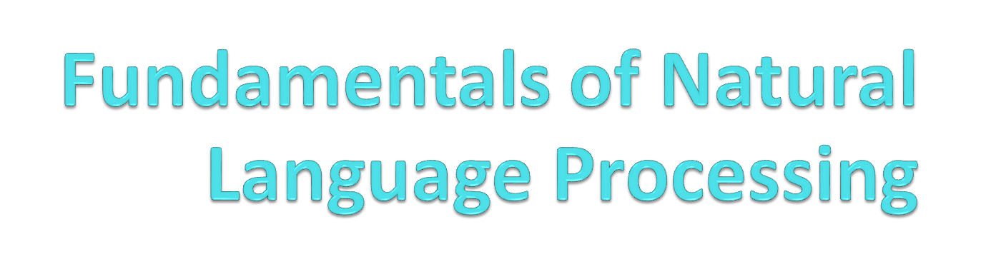
Liviu P. Dinu,
ldinu@fmi.unibuc.ro
University of Bucharest
Human Language Technologies Research Center,
Faculty of Mathematics and Computer Science
nlp.unibuc.ro

Slide 2
Welcome!

Slide 3
Main References
Dan Jurafsky and James H. Martin. Speech and Language Processing(3rd ed. draft) (https://web.stanford.edu/~jurafsky/slp3/)
Chris Manning and Hinrich Schütze, Foundations of Statistical Natural Language Processing, MIT Press. Cambridge, MA: May 1999. (https://nlp.stanford.edu/fsnlp/, https://www.cs.vassar.edu/~cs366/docs/Manning_Schuetze_StatisticalNLP.pdf)
https://www.aclweb.org/anthology/

Slide 4
Preliminaries

Slide 5
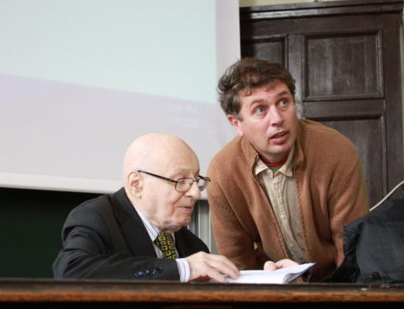
Solomon Marcus (1925-2016) view
A good interdisciplinary researcher must be a (very) good one in his main field.
Mathemathics (calculus)
Informatics (Formal Languages)
Poetics
Linguistics
Semiotics
Mathematical and Computational Linguistics
Philosophy

Slide 6
Many forms of Interdisciplinarity
Doesn’t mean to beat a chess champion at tennis and viceversa!
Generally, given n hard disciplines, how many combination possibilities there are?
Is any combination an interdisciplinarity one?
(predominant) Quantitative + (predominant) Qualitative
  Examples
    Biology +Informatics
    Psychology + linguistics +informatics

Slide 7
Study case:
Computational Linguistics
or
Digital Humanities
or
Natural Language Processing
A strong interdisciplinary field, at the crossroad between socio-human sciences, computer science, logic.

Slide 8
However, there are problems!
We have a strong divide between computational and classical experts who often mistrust each other...
With classical scientists seeing computational scientists as servants to create their databases
  or as people who abuse their data for shiny but senseless publications...
And computational scientists seeing classical scientists as stubborn relics from the last century who don’t understand the usefulness of computational methods.
Credits to Johann-Mattis List and Simon Greenhill

Slide 9
More problems!
Computational scientists often lack understanding
  for the specifics of the problems in the humanities...
  where scholars have been working for centuries and often have gained great insights into those problems...
  and rightfully demand that CS respect the nature of their problems and take classical approaches seriously
Credits to Johann-Mattis List and Simon Greenhill

Slide 10
Even more!
Classical scientists often do not understand
  that computational approaches do not threaten their jobs or question the work they have done so far...
  but instead could offer the chance to gain new insights or to speed up the tedious process of qualitative analysis by providing practical help in tasks which even classical scientists will consider as repetitive and boring.
Credits to Johann-Mattis List and Simon Greenhill

Slide 11
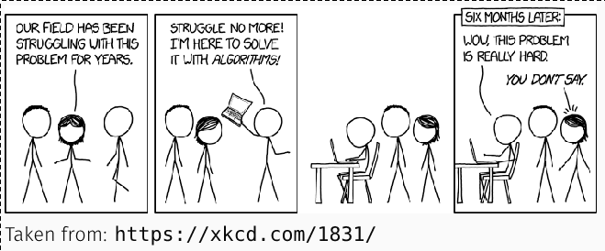

Slide 12
What Computational Scientist misunderstand or ignore
Problems in the humanities can be extremely hard
Big data approaches do not necessarily work on small data
Black box approaches are satisfying for industry applications but not for scientific endeavour
Being a mathematician does not qualify one automatically to solve problems in the humanities
Credits to Johann-Mattis List and Simon Greenhill

Slide 13
What Classical Scientist misunderstand or ignore
Computational approaches do not exclude qualitative approaches
Computational solutions can increase the consistency of “manual” data inspection
Computational approaches may provide a fresh perspective on long-standing problems in the humanities
There is no reason to be proud if one doesn’t understand basic mathematics

Slide 14
Solution?
Instead of
computer-based
vs.
classical approaches,
better (sometimes) a paradigm of
computer-assisted approaches

Slide 15
Computerised approaches
“What solution is there, then, if we can neither ignore the problem of distinguishing cognates from loanwords, nor overcome it in the many cases where we do not have the necessarily linguistic knowledge to do so? There is in fact a possibility: to sidestep the question entirely at the data analysis stage, and simply to identify which forms are judged to be somehow ‘correlate’ with each other — whether by specialists in those languages, or more objectively by computerised approaches.” (Heggarty, 2012)

Slide 16
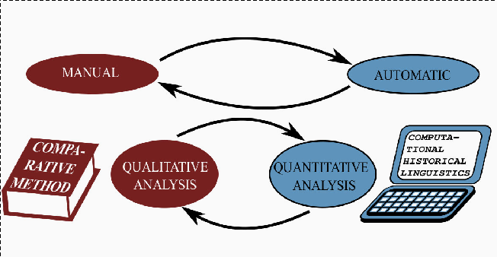
Towards CoToHiLi project
Improve computational & classic training of scholars

Slide 17
We need:
Investments in Interdisciplinarity in Higher Education.
Promote new scientific profiles (scholars who can bridge the gap between classical and computational approaches)

Slide 18
Preprocessing:
    Normalization, Tokenization
      (Segmentation), lemmatization, etc
Notes:
Credits

Slide 19
Why?
Preprocessing: one of the most undervalued and overlooked elements of NLP
Although there are blog posts abound on state of the art models and optimizers, there aren’t many posts on how to tokenize the input.
This is probably partly because it seems so easy, and partly because it just isn't sexy.
The apathy towards preprocessing is even more evident in academia

Slide 20
Main difficulty:
Language dependent!

Slide 21
Aditional bibliography
Stanford:
https://nlp.stanford.edu/IR-book/html/htmledition/tokenization-1.html
https://nlp.stanford.edu/IR-book/html/htmledition/contents-1.html
Blogs:
http://mlexplained.com/2019/11/06/a-deep-dive-into-the-wonderful-world-of-preprocessing-in-nlp/ (recommended)
https://medium.com/data-science-in-your-pocket/tokenization-algorithms-in-natural-language-processing-nlp-1fceab8454af
https://towardsdatascience.com/tokenization-for-natural-language-processing-a179a891bad4
https://blog.floydhub.com/tokenization-nlp/
https://dair.ai/notebooks/nlp/2020/03/19/nlp_basics_tokenization_segmentation.html

Slide 22
Main steps
Machine learning models need numerical inputs, so preprocessing is basically the process of taking a raw chunk of text and converting it into numbers.
Therefore, for most applications, preprocessing can roughly be divided into the following 3 steps:
  Step 1: Normalization (Cleaning)
  Step 2: Segmentation (Tokenization)
  Step 3: Numericalization (Vocabulary mapping)

Slide 23
Definitions
Normalization: is where we clean the data in advance to remove unwanted inputs and to convert certain characters/sequences into canonical forms.
Tokenization is breaking a text chunk in smaller parts. Whether it is breaking Paragraph in sentences, sentence into words or word in characters.
Numericalization: is where we convert the textual entities into numbers/ids so that we can feed them to our model.

Slide 24
Errors.
In NLP we are always dealing with of errors.
Reducing the error rate for an application often involves two antagonistic efforts:
  Increasing accuracy or precision (minimizing false positives)
  Increasing coverage or recall (minimizing false negatives).

Slide 25
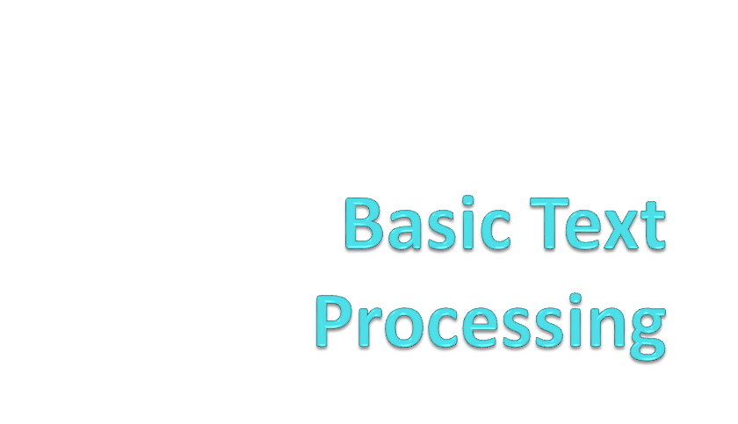
Word normalization

Slide 26
Step 1: Normalization (Cleaning)
It rather refers to the process of cleaning up the input and mapping characters/words to a "canonical" form.
  Example: mapping all characters to their lowercase form (Ciao=ciao).
Standard steps:
  Handling repeating characters (e.g. "gooooood" -> "good")
  Handling homoglyphs (e.g. "$tupid" -> "stupid")
  Mapping special inputs such as URLs, email addresses, and HTML tags to a canonical form (e.g. "http://www.foo.com/bar" -> "[URL]")
  Unicode normalization

Slide 27
Normalization
Need to “normalize” terms
  Information Retrieval: indexed text & query terms must have same form.
    We want to match U.S.A. and USA
We implicitly define equivalence classes of terms
  e.g., deleting periods in a term
Alternative: asymmetric expansion:
  Enter: window Search: window, windows
  Enter: windows Search: Windows, windows, window
  Enter: Windows Search: Windows
Potentially more powerful, but less efficient

Slide 28
Case folding
Applications like IR: reduce all letters to lower case
  Since users tend to use lower case
  Possible exception: upper case in mid-sentence?
    e.g., General Motors
    Fed vs. fed
    SAIL vs. sail
For sentiment analysis, MT, Information extraction
  Case is helpful (US versus us is important)

Slide 29
Lemmatization, morphology?
Reduce inflections or variant forms to base form
  am, are, is → be
  car, cars, car's, cars' → car
the boy's cars are different colors → the boy car be different color
Lemmatization: have to find correct dictionary headword form
Machine translation
  Spanish quiero (‘I want’), quieres (‘you want’) same lemma as querer ‘want’

Slide 30
Choosing Normalization Steps
What kinds of normalization should we actually apply?
  No clear answers to this, but:
Always look at the data manually!
Are you using a pretrained model (e.g. BERT)?
  If so, make sure your preprocessing steps match the preprocessing that is conducted for pretraining. This can be more difficutl than it seems, since papers don't always report all their preprocessing steps.

Slide 31
...
How much crucial information does normalization remove?
  In social media, saying "HELLO" and "Hello" can have different nuances. At the same time, treating "Hello world" and "hello world" differently might not make much sense. Sometimes, capitalization can indicate important grammatical information, such as the fact that a word is a proper noun (e.g. "New York").
How much data do you have?
  If you have massive amounts of data, you will probably need less normalization since the model could just learn that "Hello" and "hello" are the same underlying word from their distrubtions. But for most NLP applications you don't have such a large corpus of data, so you might want to err on the side of more normalization.

Slide 32
To be continued...
Is a large vocabulary size detrimental to your application?
  Less normalization tends to lead to a larger vocabulary, though this does depend on what kind of tokenization you use. If you are training a generative model, the output softmax layer can be a major bottleneck, and a larger vocabulary size can slow down training significantly. It can also cause out-of-memory errors, which can require smaller batch sizes, further slowing down training.

Slide 33
Word tokenization

Slide 34
Segmentation/Tokenization is probably the most complex part of the preprocessing pipeline.
  Naive tokenization algorithms,
  Rule-based tokenizers, and finally
  modern subword tokenizers that are learned on data.

Slide 35
What is a word?
What counts as a word is a vexed question in linguistics (there are words at various levels, such as phonological words versus syntactic words, which need not all be the same.)
Kucera and Francis (1967) suggested the practical notion of a graphic word which they define as string of contiguous alphanumeric characters with space on either side; may include hyphens and apostrophes, but no other punctuation marks.
What about $22.50, ☺, ☹,...?

Slide 36
How many words?
I do uh main- mainly business data processing
  Fragments, filled pauses
Seuss’s cat in the hat is different from other cats!
  Lemma: same stem, part of speech, rough word sense
    cat and cats = same lemma
  Wordform: the full inflected surface form
    cat and cats = different wordforms
  Calului sa-i dai graunte, mama lui de cal!

Slide 37
How many words?
they lay back on the San Francisco grass and looked at the stars and their
Type: an element of the vocabulary.
Token: an instance of that type in running text.
How many?
  15 tokens (or 14)
  13 types (or 12) (or 11?)

Slide 38
How many words?
N = number of tokens
V = vocabulary = set of types
  |V| is the size of the vocabulary
Church and Gale (1990): |V| > O(N^{½})
 | Tokens = N | Types = |V|
Switchboard phone conversations | 2.4 million | 20 thousand
Shakespeare | 884,000 | 31 thousand
Google N-grams | 1 trillion | 13 million

Slide 39
Simple Tokenization in UNIX
(Inspired by Ken Church’s UNIX for Poets.)
Given a text file, output the word tokens and their frequencies
tr -sc ’A-Za-z’ ’\n’ < shakes.txt
| sort
| uniq –c
1945 A
72 AARON
19 ABBESS
5 ABBOT
... ...
Change all non-alpha to newlines
Sort in alphabetical order
Merge and count each type
25 Aaron
6 Abate
1 Abates
5 Abbess
6 Abbey
3 Abbot
.... …

Slide 40
The first step: tokenizing
tr -sc ’A-Za-z’ ’\n’ < shakes.txt | head
THE
SONNETS
by
William
Shakespeare
From
fairest
creatures
We
...

Slide 41
The second step: sorting
tr -sc ’A-Za-z’ ’\n’ < shakes.txt | sort | head
A
A
A
A
A
A
A
A
A
...

Slide 42
More counting
Merging upper and lower case
tr ‘A-Z’ ‘a-z’ < shakes.txt | tr –sc ‘A-Za-z’ ‘\n’ | sort | uniq –c
Sorting the counts
tr ‘A-Z’ ‘a-z’ < shakes.txt | tr –sc ‘A-Za-z’ ‘\n’ | sort | uniq –c | sort –n –r
23243 the
22225 i
18618 and
16339 to
15687 of
12780 a
12163 you
10839 my
10005 in
8954 d
23243 the
22225 i
18618 and
16339 to
15687 of
12780 a
12163 you
10839 my
10005 in
8954 d
23243 the
22225 i
18618 and
16339 to
15687 of
12780 a
12163 you
10839 my
10005 in
8954 d
What happened here?

Slide 43
Issues in Tokenization
Finland’s capital → Finland Finlands Finland’s ?
what’re, I’m, isn’t → What are, I am, is not
Hewlett-Packard → Hewlett Packard ?
state-of-the-art → state of the art ?
Lowercase → lower-case lowercase lower case ?
San Francisco → one token or two?
m.p.h., PhD. → ??

Slide 44
Tokenization: language issues
French
  L'ensemble → one token or two?
    L ? L’ ? Le ?
    Want l’ensemble to match with un ensemble
German noun compounds are not segmented
  Lebensversicherungsgesellschaftsangestellter
  ‘life insurance company employee’
  German information retrieval needs compound splitter
Romanian
  Sau s-au dus sau nu s-au dus, spuneti-mi odata (o data?)

Slide 45
Tokenization: language issues
Chinese and Japanese no spaces between words:
  莎拉波娃现在居住在美国东南部的佛罗里达。
  莎拉波娃 现在 居住 在 美国 东南部 的 佛罗里达
  Sharapova now lives in US southeastern Florida
Further complicated in Japanese, with multiple alphabets intermingled
  Dates/amounts in multiple formats
  フォーチュン500社は情報不足のため時間あた$500K(約6,000万円)
Katakana
Hiragana
Kanji
Romaji
End-user can express query entirely in hiragana!

Slide 46
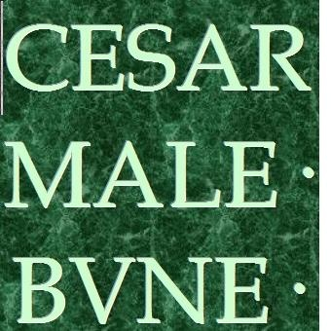
No space between words!

Slide 47
Word Tokenization in Chinese
Also called Word Segmentation
Chinese words are composed of characters
  Characters are generally 1 syllable and 1 morpheme.
  Average word is 2.4 characters long.
Standard baseline segmentation algorithm:
  Maximum Matching (also called Greedy)

Slide 48
Maximum Matching
Word Segmentation Algorithm
Given a wordlist of Chinese, and a string.
Start a pointer at the beginning of the string
Find the longest word in dictionary that matches the string starting at pointer
Move the pointer over the word in string
Go to 2

Slide 49
Max-match segmentation test
Thecatinthehat -> The cat in the hat
Thetabledownthere -> Theta bled own there?
The table down there?
dupaeitrecuradoi
Doesn’t generally work in English! (neither in Oltenia!)
But works astonishingly well in Chinese
  莎拉波娃现在居住在美国东南部的佛罗里达。
  莎拉波娃 现在 居住 在 美国 东南部 的 佛罗里达
Modern probabilistic segmentation algorithms even better
  the cat in the hat
  the table down there
  theta bled own there

Slide 50
Tokenizing on Whitespaces/Punctuation
The most naive form of tokenization.
"I saw a girl with a telescope."
  This would be split into
"I", "saw", "a", "girl", "with", "a", "telescope.“
Never use purely whitespace tokenization in NLP!
A slightly better approach is to tokenize based on punctuation like
  "I", "saw", "a", "girl", "with", "a", "telescope", "."

Slide 51
...
What do you, for instance, with an ellipsis?
Do you want it split into three periods (".", ".", ".") or would you rather it be a single token?
What about words like "don't"?
  Should it be split into "do" and "n't"?
  Or should it be a single word?
  Or maybe "don", "'", "t"?
What about emoticons like ":)" and abbreviations like "U.S.A."?
Clearly, simply tokenizing on whitespaces and punctuation is insufficient if we want the best performance, which motivates us to pursue more complex, rule-based tokenization methods.

Slide 52
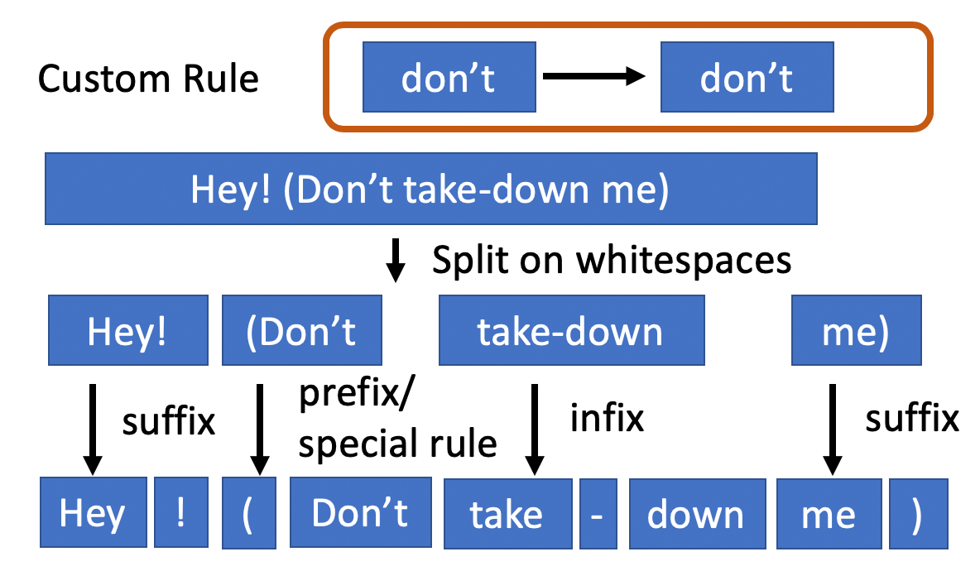
Rule-based Tokenization
Allow us to tokenize more intelligently on a case-by-case basis

Slide 53
Examples
Spacy
The Spacy tokenizer is a modern tokenizer that is widely used for a good reason: it's fast, provides reasonable defaults, and is easily customizable.
Spacy allows the user to specify special tokens that will not be segmented, or will be segmented in some specific ways.
  For instance, if you want to keep the ellipsis as a single token, you can specify that as a rule, and the rule will take precedence over other splitting operations.
Spacy splits on spaces and then looks through each individual substring. It first looks for special tokens, and when special tokens are not present, splits off certain prefixes (such as punctuation), then suffixes, and infixes.

Slide 54
Moses
The Moses tokenizer is a classic tokenizer that is much older than Spacy and is used widely in machine translation. Compared to Spacy, it is less customizable and is more opiniated.
The Moses tokenizer internally replaces certain special tokens (e.g. ellipses) with custom tokens, and is a good example of how normalization and tokenization are not always cleanly divided.
Moses performs fairly well on plain English, but if you are handling text like social media text, it can cause problems with certain inputs like emoticons.

Slide 55
Important!
I’ll and isn’t and friends: These count as one graphic word according to some definition, but many people have a strong intuition that we really have two words here as these are contractions for I will and is not.
Thus some processors (and some corpora, such as the Penn Treebank) split such contractions into two words, while others do not.

Slide 56

Sentence Segmentation and Decision Trees

Slide 57
Sentence Segmentation
What is a sentence?
The first answer to what is a sentence is something ending with a “.” or “!”
!, ? are relatively unambiguous
Period “.” is quite ambiguous
  Sentence boundary
  Abbreviations like Inc. or Dr.
  Numbers like .02% or 4.3
Build a binary classifier
  Looks at a “.”
  Decides EndOfSentence/NotEndOfSentence
  Classifiers: hand-written rules, regular expressions, or machine-learning

Slide 58
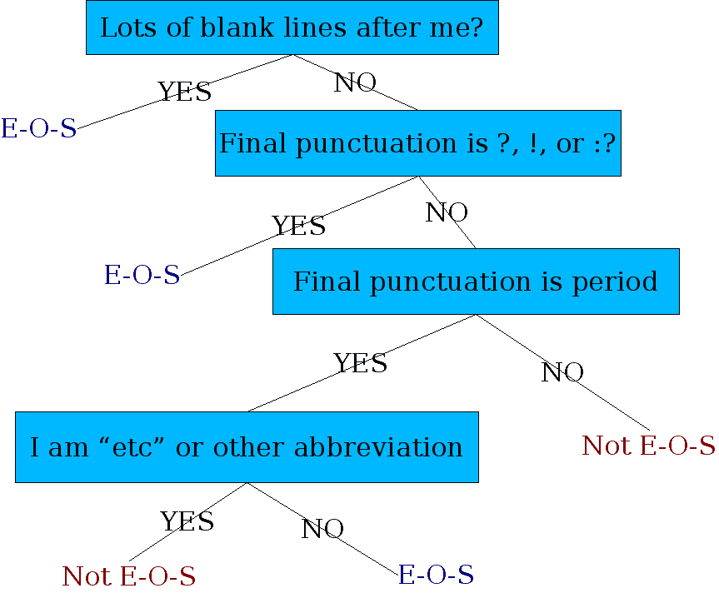
Determining if a word is end-of-sentence: a Decision Tree

Slide 59
More sophisticated decision tree features
Case of word with “.”: Upper, Lower, Cap, Number
Case of word after “.”: Upper, Lower, Cap, Number
Numeric features
  Length of word with “.”
  Probability(word with “.” occurs at end-of-s)
  Probability(word after “.” occurs at beginning-of-s)

Slide 60
Implementing Decision Trees
A decision tree is just an if-then-else statement
The interesting research is choosing the features
Setting up the structure is often too hard to do by hand
  Hand-building only possible for very simple features, domains
    For numeric features, it’s too hard to pick each threshold
  Instead, structure usually learned by machine learning from a training corpus

Slide 61
Decision Trees and other classifiers
We can think of the questions in a decision tree
As features that could be exploited by any kind of classifier
  Logistic regression
  SVM
  Neural Nets
  etc.

Slide 62
MULTUMESC!

Slide 63
Liviu P. Dinu,
ldinu@fmi.unibuc.ro
University of Bucharest
Human Language Technologies Research Center,
Faculty of Mathematics and Computer Science
nlp.unibuc.ro

Slide 64
Preprocessing:
    Lemmatization, stemming

Slide 65
Lemmatizations. Definitions
Variations of a word are called wordforms or surface forms.
By reducing these wordforms to a common root, we simplify the input. The root form is called lemma.
Lemmatization is the task of determining that two words have the same root, despite their surface differences.
  am, are, and is have the shared lemma be;
  dinner and dinners both have the lemma dinner.
  He is reading detective stories -> He be read detective story.
An algorithm or program that determines lemmas from wordforms is called a lemmatizer.

Slide 66
Examples
Shakespeare's works: about 880K words, 29K wordforms, and 18K lemmas.
Lemmatization involves word morphology, which is the study of word forms.
Typically, we identify the morphological tags of a word before selecting the lemma.

Slide 67
Why?
Many NLP tasks can benefit from lemmatization.
Examples:
  topic modelling looks at word distribution in a document.
  By normalizing words to a common form, we get better results (In word embeddings removing inflected wordforms can improve downstream NLP tasks.
  For information retrieval (IR), lemmatization helps with query expansion so that suitable matches are returned even if there's not an exact word match.
  In document clustering, it's useful to reduce the number of tokens. It also helps in machine translation.
The decision to use lemmas is application dependent; we should use lemmas only if they show better performance.

Slide 68
How is lemmatization done? ?
M: the way words are built up from smaller meaning-bearing units called morphemes.
Two broad classes of morphemes : stems—the central morpheme of the word, the main meaning— and affixes—adding “additional” meanings of various kinds.
Example:
  the word fox consists of one morpheme (fox)
  the word cats consists of two: cat and -s.
  Spanish word like amaren (‘if in the future they would love’) into the morphemes amar ‘to love’, 3PL, and future subjunctive.

Slide 69
Lemmatization. How?
Use predefintie dictionnaries:
https://cst.dk/download/cstlemma/
https://www.clarin.si/repository/xmlui/handle/11356/1041
This works well for straightforward inflected forms, but ...
A rule-based system will be needed for other cases, such as in languages with long compound words.
Such rules can be either hand-crafted or learned automatically from an annotated corpus.

Slide 70
Challenges with lemmatization
Out-of-vocabulary (OOV) words
  WordNet doesn't have the word 'carmaking'.
It difficult to construct rules for irregular word inflections
When content comes from Internet or social media, it's impractical to use predefined dictionary.
Even with neural networks, some inflected forms might never occur in training, such as, 'forbade', the past tense of 'forbid'.
Many training corpora come from newspaper texts where verbs in second person are rare. This can impact lemmatization of such forms.

Slide 71
Preprocessing:
    Lemmatization, stemming

Slide 72
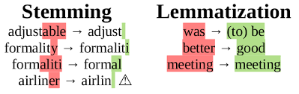
Lemmatization vs stemming
Given a wordform, stemming is a simpler way to get to its root form.
Stemming simply removes prefixes and suffixes.
Lemmatization on the other hand does morphological analysis, uses dictionaries and often requires part of speech information.
Thus, lemmatization is a more complex process.
Stems need not be dictionary words but lemmas always are.

Slide 73
Stemm vs Lemma
Another way to say this is that "a lemma is the base form of all its inflectional forms, whereas a stem isn't".
Wordforms are either inflectional (change of tense, singular/plural) or derivational (change of part of speech or meaning).
Lemmatization usually collapses inflectional forms whereas stemming does this for derivational forms.
Stemming may suffice for many use cases in English. For morphologically complex languages such as Arabic, lemmatization is essential.

Slide 74
More problems!
There are two types of problems with stemming that lemmatization can solve:
Two wordforms with different lemmas may stem to the same result. Eg. 'universal' and 'university' result in same stem 'univers‘; bussiness=busy!
Two wordforms of same lemma may end as two different stems. Eg. 'good' and 'better' have the same lemma 'good'.

Slide 75
Stemming
Reduce terms to their stems in information retrieval
Stemming is crude chopping of affixes
  language dependent
  e.g., automate(s), automatic, automation all reduced to automat.
for example compressed
and compression are both
accepted as equivalent to
compress.
for exampl compress and
compress ar both accept
as equival to compress

Slide 76
Porter’s algorithm. The most common English stemmer
Step 1a
  sses → ss caresses → caress
  ies → i ponies → poni
  ss → ss caress → caress
  s → ø cats → cat
Step 1b
  (*v*)ing → ø walking → walk
  sing → sing
  (*v*)ed → ø plastered → plaster
  …
Step 2 (for long stems)
  ational→ ate relational→ relate
  izer→ ize digitizer → digitize
  ator→ ate operator → operate
  …
Step 3 (for longer stems)
  al → ø revival → reviv
  able → ø adjustable → adjust
  ate → ø activate → activ
  …

Slide 77
Why only strip –ing if there is a vowel?
  (*v*)ing → ø walking → walk
  sing → sing
1312 King
548 being
541 nothing
388 king
375 bring
358 thing
307 ring
152 something
145 coming
130 morning
548 being
541 nothing
152 something
145 coming
130 morning
122 having
120 living
117 loving
116 Being
102 going

Slide 78
Dealing with complex morphology is sometimes necessary
Some languages requires complex morpheme segmentation
  Turkish
  Uygarlastiramadiklarimizdanmissinizcasina
  `(behaving) as if you are among those whom we could not civilize’
  Uygar `civilized’ + las `become’
    + tir `cause’ + ama `not able’
    + dik `past’ + lar ‘plural’
    + imiz ‘p1pl’ + dan ‘abl’
    + mis ‘past’ + siniz ‘2pl’ + casina ‘as if’

Slide 79
Romanian Snowball https://snowballstem.org/algorithms/romanian/stemmer.html
ocol
ocolea
ocolesc
ocoleşte
ocoleşti
ocoli
ocolim
ocolind
ocolire
ocolişuri
ocolit
ocolită
ocoliţi
ocolul
ocoluri
ocolurile
ocol
ocol
ocol
ocol
ocol
ocol
ocol
ocol
ocol
ocolişur
ocol
ocol
ocol
ocol
ocolur
ocolur

Slide 80
The stemming algorithm
Letters in Romanian include the following accented forms, ă â î ş ţ
The following letters are vowels: a ă â e i î o u
First, i and u between vowels are put into upper case (so that they are treated as consonants).
Most of the stemmers make use of at least one of the region definitions R1 and R2. They are defined as follows:
R1 is the region after the first non-vowel following a vowel, or is the null region at the end of the word if there is no such non-vowel.
R2 is the region after the first non-vowel following a vowel in R1, or is the null region at the end of the word if there is no such non-vowel.
.

Slide 81
Ro snowball algorithm
Always do steps 0, 1, 2 and 4. (Step 3 is conditional on steps 1 and 2.)
Step 0: Removal of plurals (and other simplifications)
  Search for the longest among the following suffixes, and, if it is in R1, perform the action indicated.
    ul ului: delete;
    aua replace with a;
    ea ele elor replace with e;
    ii iua iei iile iilor ilor replace with i;
    ile replace with i if not preceded by ab;
    atei replace with at;
    aţie aţia replace with aţi;

Slide 82
Step 1: Reduction of combining suffixes
Search for the longest among the following suffixes, and, if it is in R1, preform the replacement action indicated. Then repeat this step until no replacement occurs.
  abilitate abilitati abilităi abilităţi replace with abil
  ibilitate replace with ibil
  ivitate ivitati ivităi ivităţi replace with iv
  icitate icitati icităi icităţi icator icatori iciv iciva icive icivi icivă ical icala icale icali icală replace with ic
  ativ ativa ative ativi ativă aţiune atoare ator atori ătoare ător ători replace with at
  itiv itiva itive itivi itivă iţiune itoare itor itori replace with it

Slide 83
Step 2: Removal of ‘standard’ suffixes
Search for the longest among the following suffixes, and, if it is in R2, perform the action indicated.
  at ata ată ati ate ut uta ută uti ute it ita ită iti ite ic ica ice ici ică abil abila abile abili abilă ibil ibila ibile ibili ibilă oasa oasă oase os osi oşi ant anta ante anti antă ator atori itate itati ităi ităţi iv iva ive ivi ivă delete
  iune iuni delete if preceded by ţ, and replace the ţ by t.
  ism isme ist ista iste isti istă işti replace with ist
Do step 3 if no suffix was removed either by step 1 or step 2.

Slide 84
Step 3: Removal of verb suffixes
Search for the longest suffix in region RV among the following, and perform the action indicated.
  are ere ire âre ind ând indu ându eze ească ez ezi ează esc eşti eşte ăsc ăşti ăşte am ai au eam eai ea eaţi eau iam iai ia iaţi iau ui aşi arăm arăţi ară uşi urăm urăţi ură işi irăm irăţi iră âi âşi ârăm ârăţi âră asem aseşi ase aserăm aserăţi aseră isem iseşi ise iserăm iserăţi iseră âsem âseşi âse âserăm âserăţi âseră usem useşi use userăm userăţi useră delete if preceded in RV by a consonant or u
  ăm aţi em eţi im iţi âm âţi seşi serăm serăţi seră sei se sesem seseşi sese seserăm seserăţi seseră delete

Slide 85
Step 4: Removal of final vowel
Definition: :
  If the second letter is a consonant, RV is the region after the next following vowel, or if the first two letters are vowels, RV is the region after the next consonant, and otherwise (consonant-vowel case) RV is the region after the third letter. But RV is the end of the word if these positions cannot be found.
Search for the longest among the suffixes a e i ie ă and, if it is in RV, delete it.
And finally: turn I, U back into i, u.

Slide 86
To stemm or not to stemm..
One might be tempted to conclude that, in languages with rich morphology, one would gain by stripping inflectional morphology but not derivational morphology.
This hypothesis remains to be carefully tested in languages where there is sufficient inflectional morphology for the question to be interesting.
It is important to realize that this result from IR need not apply to any or all Statistical NLP applications.
It need not even apply to all of IR.
Morphological analysis might be much more useful in other applications.

Slide 87
To stemm?
Stemming does not help in the non-interactive evaluation of IR systems, where a query is presented and processed without further input, and the results are evaluated in terms of the appropriateness of the set of documents returned.
However, principled morphological analysis is valuable in an interactive context, the context in which should really be evaluated.
A computer does not care about weird stems like busy from business, but people do. They do not understand what is going on when business is stemmed to busy and a document with busy in it is returned.

Slide 88
To stemm?
Extensive empirical research within the Information Retrieval (IR) community has shown that doing stemming does not help the performance of classic IR systems when performance is measured as an average over queries 1989; Hull 1996).
There are always some queries for which stemming helps a lot.
But there are others where performance goes down.
This is a somewhat surprising result, especially from the viewpoint of linguistic intuition, and so it is important to understand why that is.

Slide 89
Three main reasons
One: while grouping the various forms of a stem seems a good thing to do, it often costs you a lot of information.
  For instance, while operating can be used in a periphrastic tense form as in Bill is operating a tractor, it is usually used in noun- and adjective-like uses such as operating systems or operating costs. It is not hard to see why a search for operating systems will perform better if it is done on inflected words than if one instead searches for all paragraphs that contain

Slide 90
3 reasons!
Two: Secondly, morphological analysis splits one token into several. However, often it is worthwhile to group closely related information into chunks, notwithstanding the blowout in the vocabulary that this causes.
  Indeed, in various Statistical NLP domains, people have been able to improve system performance by regarding frequent multiword units as a single distinctive token.
  Often inflected words are a useful and effective chunk size.

Slide 91
3 reasons
Three: most information retrieval studies have been done on English although recently there has been increasing multilingual work.
English has very little morphology, and so the need for dealing intelligently with morphology is not acute.
Many other languages have far richer systems of inflection and derivation, and then there is a pressing need for morphological analysis. A lexicon for such languages, one that separately lists all inflected forms of all words, would simply be too large. (eg Bantu languages (spoken in central and southern Africa display rich verbal morphology.)

Slide 92
MULTUMESC!
Tesekkur ederim!

